Slide 1
Dynamics of Pre-Frontal Rainfall in the Southern Alps
Marc Collins
B.S. Candidate Applied Meteorology
Embry-Riddle Aeronautical University
Mentor:
Dr. Curtis N. James
Arizona Space Grant Symposium
Saturday, April 21, 2012

Slide 2
Heavy Precipitation in the Alps
The Lago Maggiore region is the site of a local maximum in annual precipitation.
Prolonged heavy rainfall in the region leads to flash flooding, especially in river valleys.
Motivation: Improved understanding of flash flooding in mountainous regions.

Slide 3
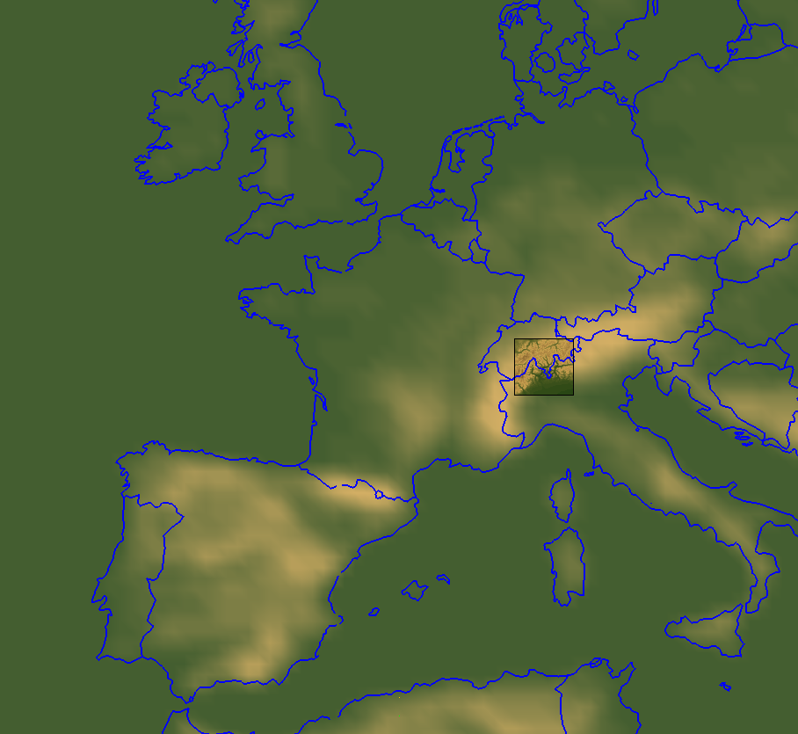
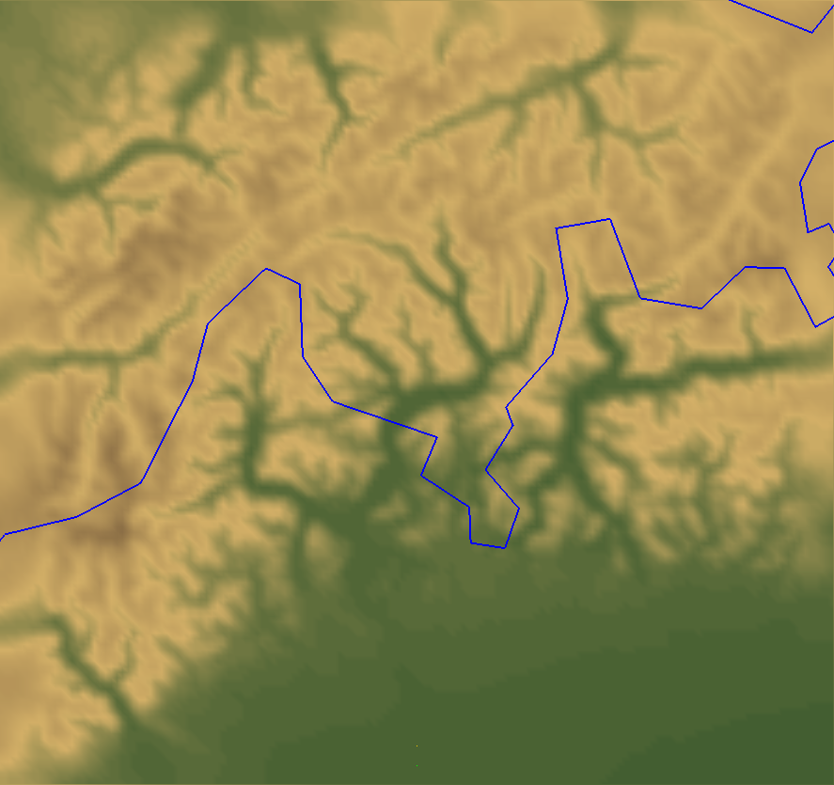
Where is the Lago Maggiore Region?
Switzerland
Maggia Valley
Lago Maggiore
Italy

Slide 4
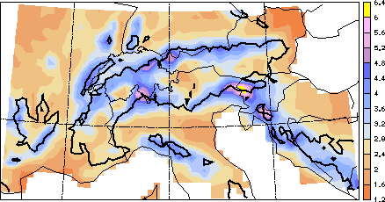
Annual Precipitation Rate
Mean annual precipitation [mm/d] for the period 1971–1990. The thick line represents the 800 m MASL topographic contour (Frei and Schär 1998).

Slide 5
Investigating Flash Floods near Lago Maggiore
Numerical model simulations were performed for the top 8 flood events between 2006 and 2011.
  Events selected from peak river flow rates in the Maggia River (≥ 978 m3/s!!!)
The simulations provide a high-resolution, physically consistent representation of the atmospheric structure for each event.

Slide 6
Basic Simulation Information
The Advanced Research Weather Research and Forecasting Model (WRF-ARW) was configured as follows:
  3 nested domains
  3 km horizontal resolution on innermost domain
  This resolution was sufficiently high to explicitly simulate deep convective processes in the atmosphere

Slide 7
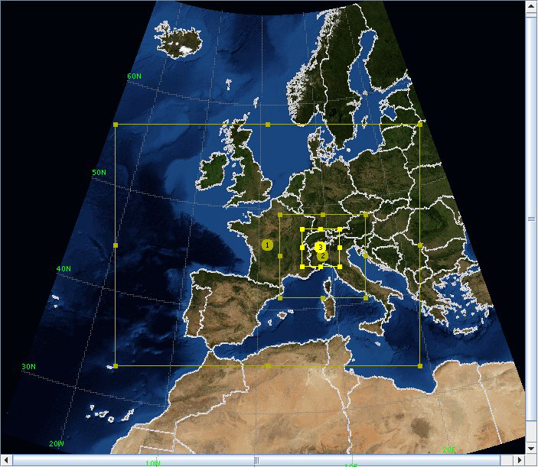
Simulation Configuration

Slide 8
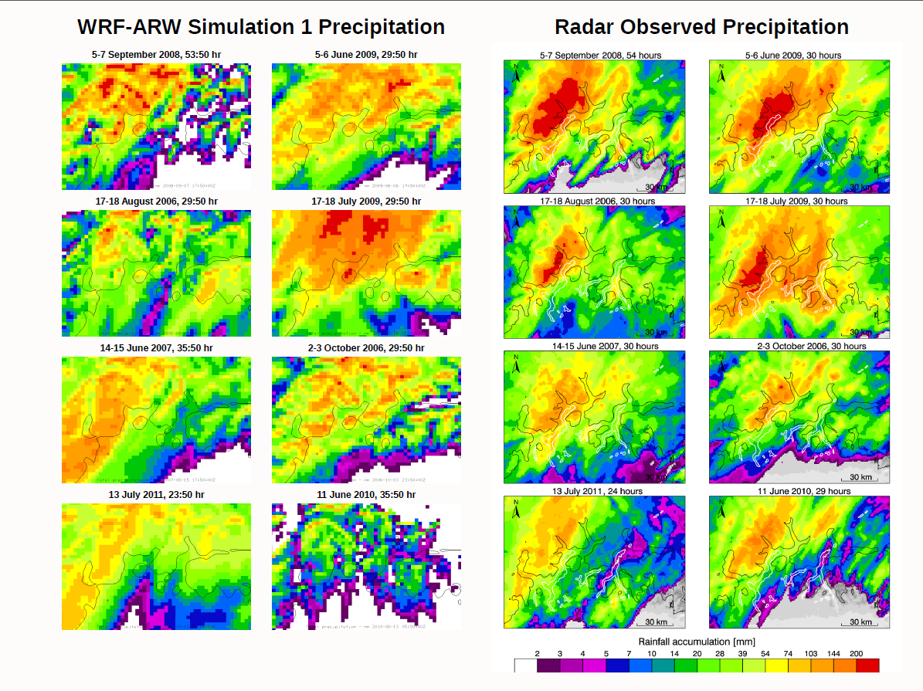

Slide 9
Simulation Results
Fine-scale details (such as location and intensity of maximum rainfall) are inaccurate when compared with radar observations of the events.
In most events, spatial distribution of simulated precipitation roughly corresponds to radar observed precipitation.
Therefore, the model is able to produce realistic precipitation distributions, even though exact details are incorrect.

Slide 10
Simulation Results
Since the model appears to produce realistic simulations of heavy rain events, we used the model results to gain insight into the structure of such events.
Most simulations depict a combination of the following rainfall types:
  Unstable:
    Showers or thunderstorms (or convection) associated with a cold front
    Convection in advance of a cold front
  Stable:
    Stratiform rain (horizontally layered precipition)

Slide 11
Simulation Results
Convection associated with cold fronts is normally intense but short-lived in the simulations, while stratiform rain is much less intense but prolonged.
By contrast, pre-frontal convection can be both intense and long-lived.
It also exhibits echo-training, which means that thunderstorm cells form and propagate over the same areas repeatedly.
Therefore, it appears that pre-frontal convection can be a major contributor to heavy rainfall and flash flooding in the region.

Slide 12
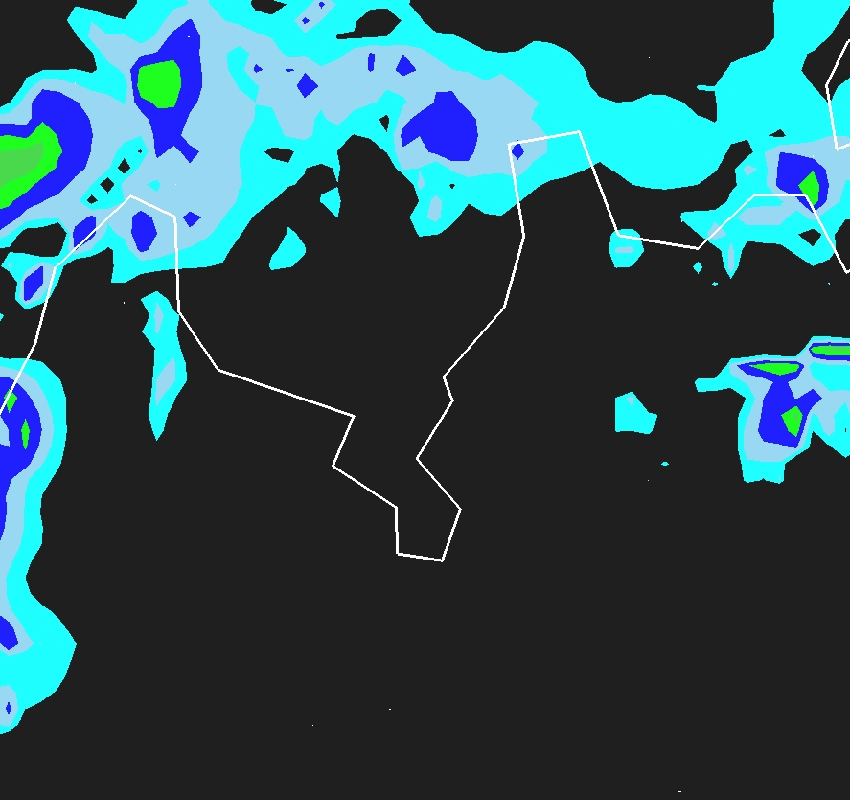

Slide 13
What Causes Echo-Training?
Simulation results indicate that the orientation of the Alpine foothills with respect to low and mid level flow favors echo-training pre-frontal convection.
For the eight cases studied, the prevailing low-level wind is southeasterly upstream from the Alps, perpendicular to the foothills
  This triggers thunderstorms along foothill slopes in southwest to northeast oriented lines.
At the same time, mid-level flow is generally southwesterly, parallel to the Alpine crest.
  This mid-level flow steers these thunderstorm cells northeastward in succession across the Maggia Valley.

Slide 14
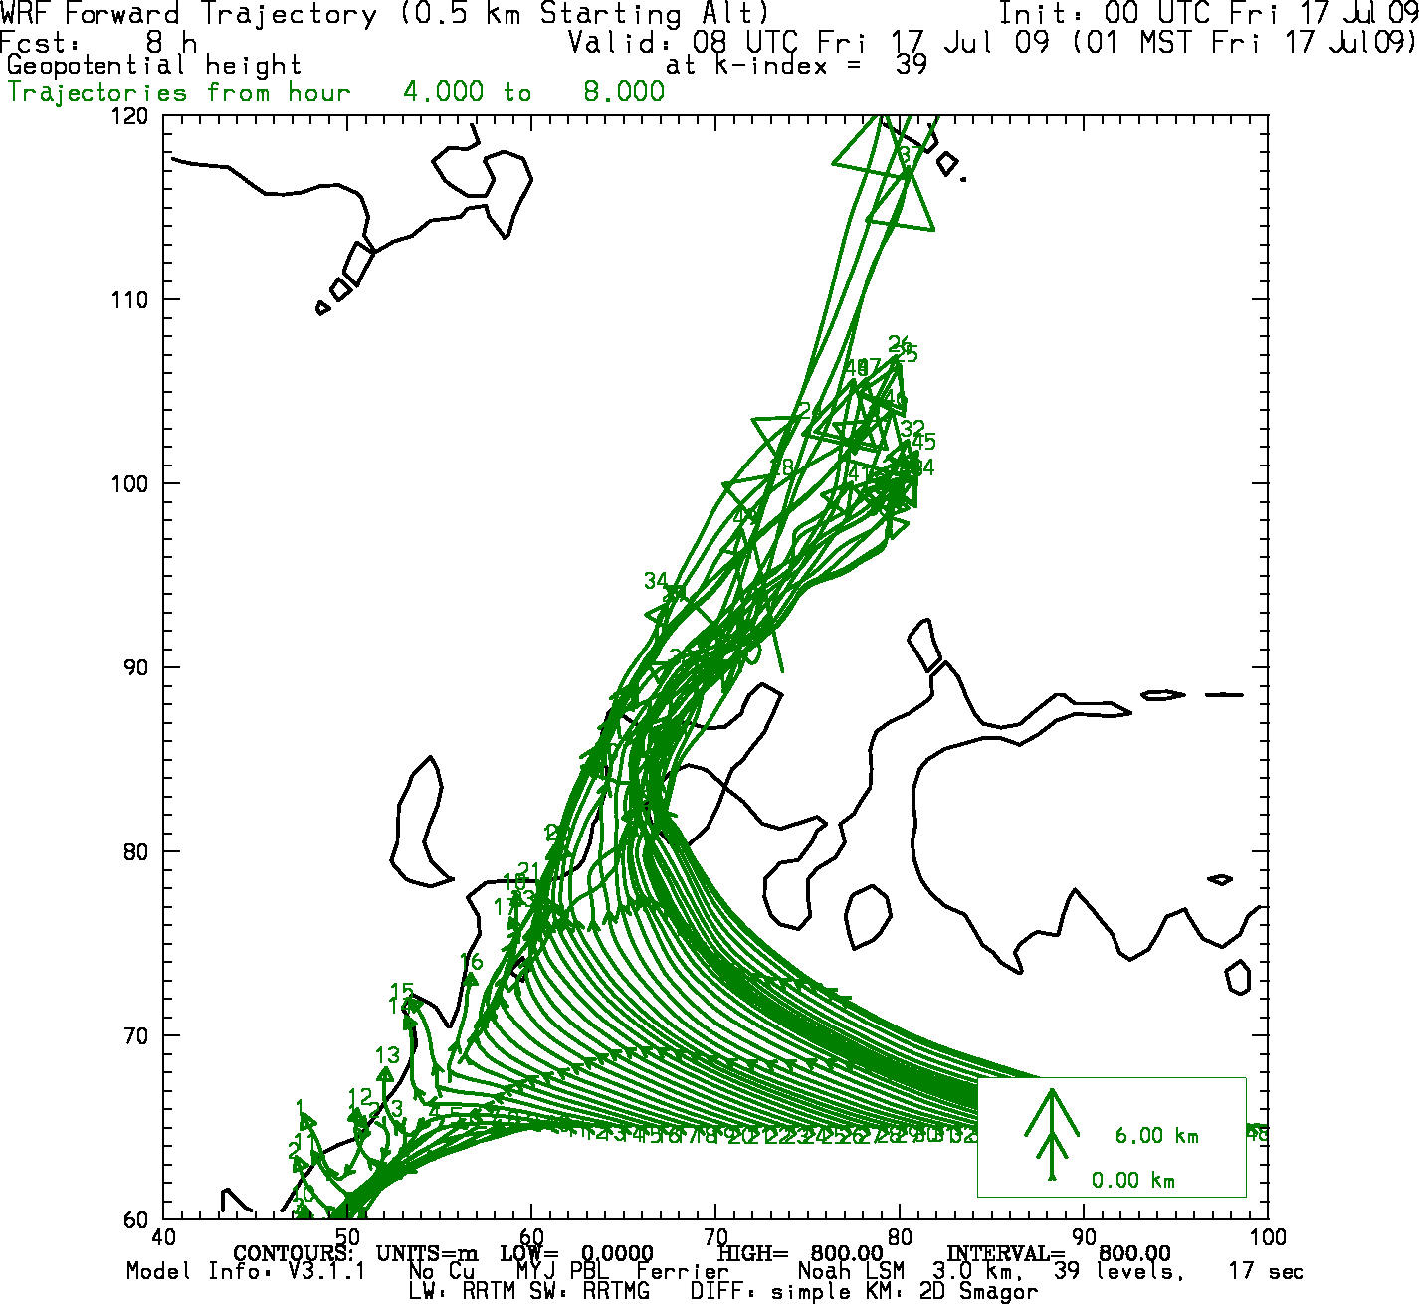
Forward Trajectory
Rising air in Thunderstorm updrafts drifts northeastward under the influence of steering flow.
Winds converge and rise along Alpine slopes
Southeasterly winds upstream of Alps

Slide 15
Conclusions
The Lago Maggiore region receives locally heavy annual rainfall, and it is often prone to flash flooding.
To gain a better understanding of the dynamics of flash flood events, WRF-ARW simulations were performed for the top 8 flood events in the Maggia River between 2006 and 2011.
The simulations reveal the importance of sustained pre-frontal convection during heavy rainfall events.
This pre-frontal convection often exhibits echo-training.
Simulation results show that the local orientation of the Alps with respect to low and mid level air flow favors echo training.

Slide 16
Thank You!

